Slide 1

For internal circulation only

Slide 2

For internal circulation only

Slide 3

For internal circulation only

Slide 4

For internal circulation only

Slide 5

For internal circulation only

Slide 6

For internal circulation only

Slide 7

Cumulative Bonus Booster
Enjoy unlimited 100% cumulative bonus of your Sum Insured every year, even if you claim.
Note : CB Booster is provided under Add-on policy Care Advanced
For internal circulation only

Slide 8

For internal circulation only

Slide 9
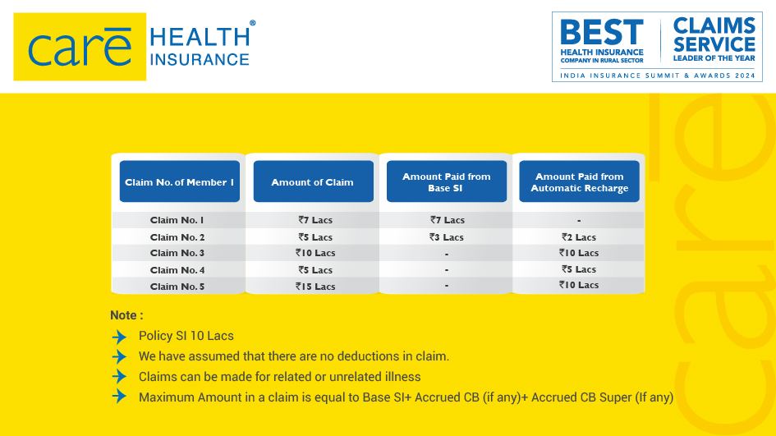
For internal circulation only

Slide 10

For internal circulation only

Slide 11
UNLIMITED CARE allows ONE BIG CLAIM in entire policy lifetime to be paid irrespective of coverage amount in the policy.
Note :
This benefit can be opted only at the inception of the policy irrespective of the policy tenure
Once opted in policy Unlimited care can only be removed after 5 years
Once a claim is made under this benefit, the cover shall cease and not be available for re-selection during the subsequent renewal
Only one claim is allowed in policy lifetime irrespective of no. of insured members in policy
This benefit will get triggered after the utilization of Base Sum Insured, Cumulative Bonus and Cumulative Bonus Super or Cumulative Bonus Booster
Claim filled under this benefit has to be accepted and approved by the company.
Unlimited Care is provided under Add-on policy Care Advanced
For internal circulation only

Slide 12

OPD Coverage
CARE OPD
Each insured is eligible for 4 Physical Consultations from a General Physician in a Year. Max. Rs.500/- will be reimbursed per consultation
Each insured is eligible for 4 Physical Consultation from 14 Specified Specialists( List Given Below) in a Year. Max. Rs.500/- will be reimbursed per consultation
Care OPD Plus
Each insured is eligible for 4 Physical Consultations from a General Physician in a Year. Max. Rs.1000/- with co-payment of 10% will be reimbursed per consultation
Each insured is eligible for 4 Physical Consultation from 14 Specified Specialists( List Given Below) in a Year. Max. Rs.2000/- with co-payment of 5% will be reimbursed per consultation
Unlimited Online Fitness Session in our Mobile Application
List of Specialist Doctors for Physical Consultations
Pediatrician | Psychiatrist
Obstetrics and Gynecologist | Cardiologist
Homeopathic Physician | Neurologist
Dietician | Orthopedic Surgeon
Diabetologist | Nephrologist
Dermatologist | ENT Specialist
Pulmonologist | Gastroenterologist
Note : OPD coverage is provided under Add-on policy CARE OPD

Slide 13

For internal circulation only

Slide 14
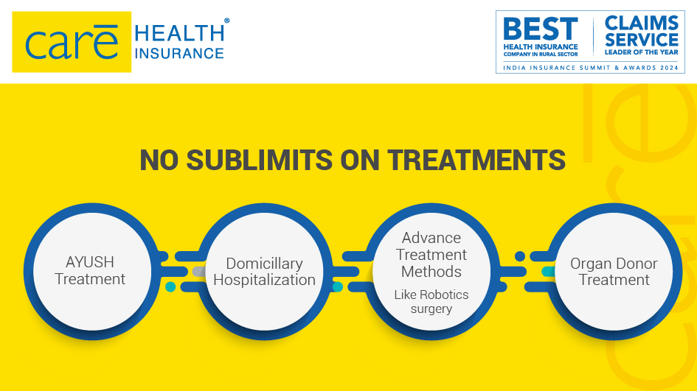
For internal circulation only

Slide 15

For internal circulation only

Slide 16

For internal circulation only

Slide 17

For internal circulation only

Slide 18

For internal circulation only

Slide 19

Benefit Name | Coverage
SI Options( Including PLUS BENEFIT amount) | 7L/10L/15L/25L/50L & 1 Cr
Room Rent | All Category Rooms Allowed
ICU | No Limit
In-Patient Care | Up to SI
Day Care Treatment | All Day Care Procedures ; Up to SI
Advance Technology Methods | Up to SI
Pre-Hospitalization Medical Expenses | Up to SI, up to 60 days prior to hospitalization
Post Hospitalization Medical Expenses | Up to SI, up to 180 days after discharge
AYUSH Treatment | Up to SI
Domiciliary Hospitalization | Up to SI
Organ Donor Cover | Up to SI
Road Ambulance Cover | Up to Rs.10,000 per year for SI<15 Lacs, Up to SI for SI>=15 Lacs
Cumulative Bonus | 50% of SI per year, max up to 100% of SI; Claim will not reduce Bonus Accrued
Unlimited Automatic Recharge | Available for unlimited times for unrelated or same illness.
Unlimited E-Consultations | Available for Consultations with General Physicians
Health Services | Discounts Vouchers on consultations, diagnostics, etc available on our Mobile App Discount Connect – Discounts on services such as consultations, diagnostics, maternity etc . at our network.
For internal circulation only

Slide 20
Cumulative Bonus Super
Up to 100% increase in SI every year Max increase 500%
Cumulative Bonus Booster
100% of Base Sum Insured per year irrespective of claim for unlimited times on continuous renewal of policy
Air Ambulance
Up to 5Lac
Wellness Benefit
Discount on renewal premium & access to online fitness session
Modification of PED Wait Period
PED wait period will be modified to
1 year or 2 years as opted
Annual Health Check--up
Once every year for all insured members
Unlimited Care
Any one claim during the lifetime of the policy without any limit on sum insured
Claim Shield: Coverage of expense related to 68 non-payable items during hospitalization
Claim Shield + List of items as per annexure I (list I, II, III and IV) that are non-payable shall be covered
Be-fit
Avail access to gyms unlimited times in a policy year. Only applicable for insured person above 12 years of age
Care OPD
4 Physical Consultations from a General Physician & Specialist each per insured max up to 500/-per consultation
Instant Cover and Instant Cover Plus
PED Waiting period reduced to 30 days for
specified declared PEDs in policy
Care OPD Plus
4 Physical Consultations with GP max 1000 per consultation; co-payment of 10% & 4 Physical Consultations with 14 specified specialists max 2000 per consultation; co-payment of 5%
All the above mentioned benefits are Optional or Mandate as per sales preposition
Instant Cover benefit applicable for Hypertension, Diabetes, Hyperlipidemia or Asthma are declared as PED in Policy; Instant Cover Plus benefit applicable for Hypertension, Diabetes, Hyperlipidemia, Asthma, COPD, Obesity or PTCA done prior to one year are declared as PED in Policy
Customer can opt either of the add-ons: Claim Shield or Claim Shield +, CB Super or CB Booster, Instant Cover or Instant Cover Plus or PED Wait Period Modification , Care OPD or Care OPD Plus
Instant Cover Plus, CB Booster, Unlimited Care & Care Shield Plus are provided under Add-on policy Care Advanced
For internal circulation only

Slide 21
BOUNDARY CONDITIONS
Age of Proposer | 18 years or above
Entry Age – Minimum | Adult : 18 years; Child : 91 Days (FF)
Entry Age – Maximum | Adult: No Upper Age Limit; Child: 24 Years
Exit Age | Adult: Lifelong; Child: 25 Years
Cover Type | Individual: max up to 6 persons; Floater: max up to 2A2C
Tenure Options | 1/2/3 Years
Pricing | Zone 1 - Delhi NCR, Surat, Mathura, Aligarh Zone 2 – Mumbai (MMR),Rest of Gujarat Zone 3 - Pune, Indore, Nashik, Telangana, Zone 4 - Rest of India. Note – 1. Cities above means adjoining cities also 2. Delhi- NCR , Mumbai (MMR), is as defined by Government
Who are covered (Relationship with respect to the Proposer) | Self, spouse/live-in partner/same sex partner, son, daughter, father, mother, mother-in-law, father-in law, Grand father, grand mother
Initial Waiting Period | 30 Days for all Hospitalization except Accidental Hospitalization
Named Ailment Waiting Period | 24 months
Pre-Existing Diseases Waiting Period | 36 months
For internal circulation only

Slide 22


